Slide 1
SQL: Data Manipulation Language (DML) Part 1 (ii)
SCSD2523 Database
Semester 1 2021/2022

Slide 2
Learning Objective
At the end of the topic, students are able to:
  Write DML statements that uses the followings:
    ORDER BY
    COUNT, SUM, AVG. MIN, MAX
    GROUP BY
    HAVING
  Subqueries

Slide 3
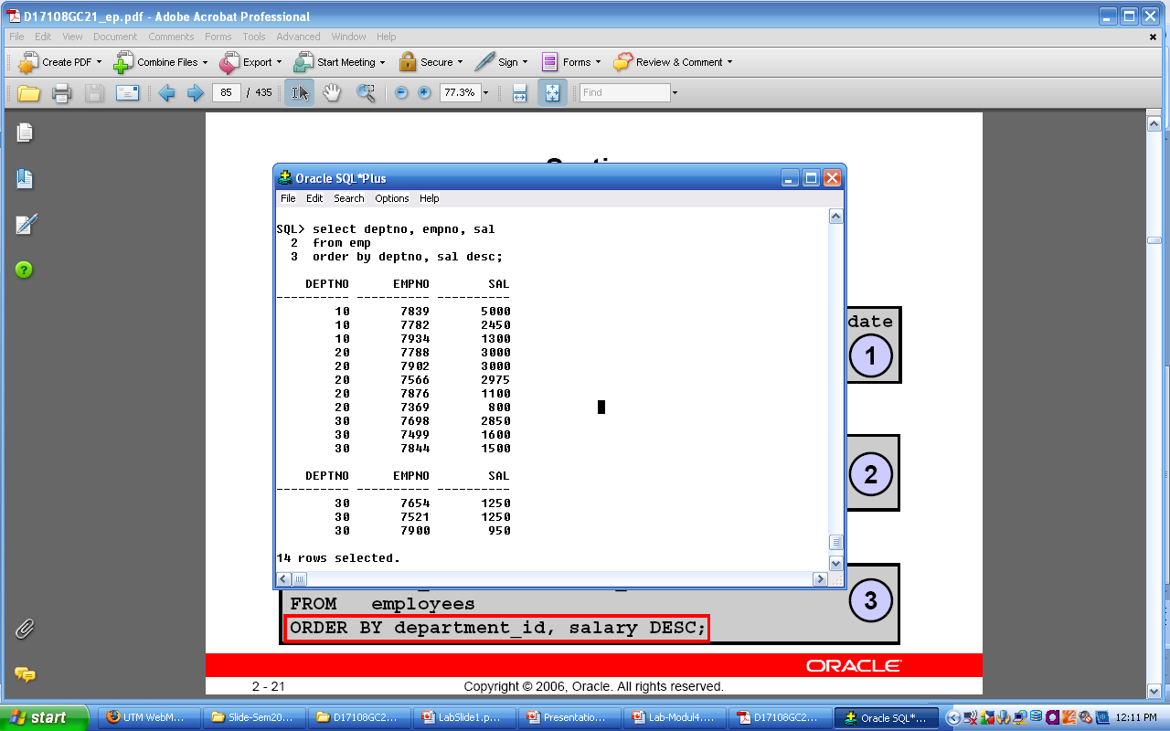
Using ORDER BY
Descending order for each department
Ascending by default
Purpose: To sort results in ascending (default) ASC or descending DESC order.
  Example:
    List employee salaries in all department, sort by department number in ascending order and by salary in descending order.
  SELECT department_id, employee_id, salary
  FROM employees
  ORDER BY department_id,
  salary DESC;

Slide 4
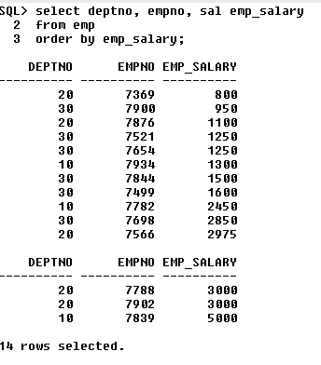
Using ORDER BY
Example:
  Display a sorted list of employee salaries in ascending order with salary column header as EMP_SALARY
  SELECT department_id, employee_id, salary emp_salary
  FROM employees
  ORDER BY emp_salary;
This will rename display of column name in output ONLY

Slide 5
Numeric Functions
ROUND: Rounds value to specified decimal
TRUNC: Truncates value to specified decimal
MOD: Returns remainder of division (modulus)
FUNCTION | RESULT
ROUND(45.926, 2) 1st parameter: the value 2nd parameter: number of decimal places to round | 45.93
TRUNC(45.926, 2) 1st parameter: the value 2nd parameter: number of decimal places to truncate | 45.92
MOD(1600, 300) | 100

Slide 6
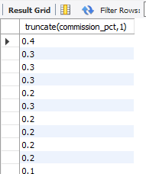
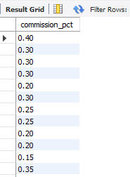
Using TRUNC (Oracle) / TRUNCATE (MySQL)
With TRUNC
Example of using TRUNC/TRUNCATE:
  SELECT TRUNC(commission_pct, 1)
  FROM employees
  WHERE commission_pct
  IS NOT NULL;
NOTE: Use TRUNCATE in MySQL
Normal data
Display normally without truncate:
  SELECT commission_pct
  FROM employees
  WHERE commission_pct
  IS NOT NULL;

Slide 7
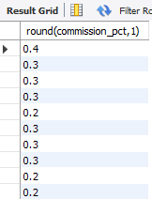
Using ROUND
With ROUND
Example of using ROUND:
  SELECT ROUND(commission_pct, 1)
  FROM employees
  WHERE commission_pct
  IS NOT NULL;
NOTE: Use TRUNCATE in MySQL
Normal data
Display normally without ROUND:
  SELECT commission_pct
  FROM employees
  WHERE commission_pct
  IS NOT NULL;

Slide 8
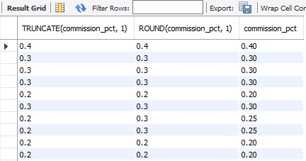
Compare ROUND, TRUNC and normal
Execute the SQL statement below to see the difference
  SELECT TRUNC(commission_pct, 1), ROUND(commission_pct, 1), commission_pct
  FROM employees
  WHERE commission_pct IS NOT NULL;
NOTE: Use TRUNCATE in MySQL

Slide 9
Aggregate Functions
Sometimes referred to as Group Functions
Can be used only in the SELECT and HAVING clause
Operate on sets of rows to give one result per group
  For numeric data:
    AVG - returns average of values in a column **
    SUM - returns the sum of values in a column **
  For numeric, character & date data types
    MAX - returns the largest value of values in a column **
    MIN - returns the smallest value of values in a column **
    COUNT - returns number of rows
  ** - Ignoring NULL values

Slide 10
Substitute NULL Values
The following functions work with any data type and pertain to using NULLs
  NVL(expr1, expr2)
    Only works in Oracle!
    For MySQL, use IFNULL(expr1, expr2)
  NVL2(expr1, expr2, expr3)
    Only works in Oracle!
    For MySQL can use IF(expr1, expr2, expr3)
  NULLIF(expr1, expr2)
    Works for both Oracle and MySQL
  COALESCE(expr1, expr2, … , exprn)
    Works for both Oracle and MySQL

Slide 11
Substitute NULL Values
Function | Description
NVL | Converts a null value to an actual value
NVL2 | If expr1 is not null, NVL2 returns expr2. If expr1 is null, NVL2 returns expr3. The argument expr1 can have any data type
NULLIF | Compares two expressions and returns null if they are equal; Returns the first expression if they are not equal
COALESCE | Returns the first non-null expression in the expression list

Slide 12
Using NVL (Oracle) / IFNULL (MySQL)
Converts a NULL value to an actual value.
Syntax:
  NVL (expr1, expr2) / IFNULL(expr1, expr2)
    expr1 is the source value or expression that may contain NULL
    expr2 is the target value for converting the null.
You can use the NVL function with any data type, but the return value is always the same as data type in expr1

Slide 13
Using NVL (Oracle) / IFNULL (MySQL)
Data types that can be used are date, character, and number
Data types must match
  NVL(commission_pct, 0) / IFNULL (commission_pct, 0)
  NVL(hire_date, ‘01-JAN-15’) / IFNULL (hire_date, ‘01-JAN-15’)
  NVL(job_id, ‘No Job Yet’) / IFNULL(job_id, ‘No Job Yet’)
Data Type | Conversion Example
NUMBER | NVL (number_column, 9)
DATE | NVL (date_column, ‘01-JAN-15’)
CHAR or VARCHAR2 | NVL (character_column, ‘Unavailable’)

Slide 14



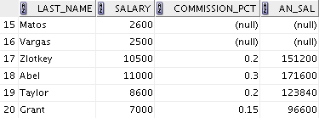
Using the NVL function
Calculate the annual salary of employees. We need to multiply the monthly salary by 12 and then add the commission percentage to the result
1
SELECT last_name, salary, commission_pct,
(salary*12) + (salary * 12 * commission_pct) ANN_SAL
FROM employees;
2
Notice that the annual salary is calculated for only employees who earn a commission.
If any column value expression is null, the result is null.
We must convert the null value to a number before applying the arithmetic operator.
…

Slide 15

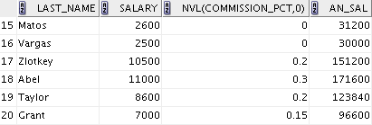
Using the NVL function
NOTE: Use IFNULL in MySQL
Calculate the annual salary of employees. We need to multiply the monthly salary by 12 and then add the commission percentage to the result
1
SELECT last_name, salary, NVL(commission_pct, 0)
(salary*12) + (salary * 12 * NVL(commission_pct, 0)) ANN_SAL
FROM employees;
2
Notice that the annual salary is calculated for only employees who earn a commission.
If any column value expression is null, the result is null.
We must convert the null value to a number before applying the arithmetic operator.
…
1
2

Slide 16
Using NVL2 (Oracle) / IF (MySQL)
The NVL2 function examines the first expression
If the first expression is not null, the NVL2 function returns the second expression
If the first expression is null, the third expression is returned
Syntax:
  NVL2 (expr1, expr2, expr3) / IF (expr1, expr2, expr3)
  expr1 is the source value or expression that may contain a null
  expr2 is the value returned if expr1 is not null
  expr3 is the value returned if expr1 is null
NOTE: Use IF in MySQL

Slide 17
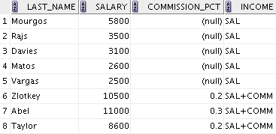
Using NVL2 (Oracle) / IF (MySQL)
The commission_pct column is examined.
  If a value is detected, the text literal value of salary+commission_pct is returned
  If the commission_pct column contains a null value, the text literal value of salary is returned
NOTE: Use IF in MySQL
1
SELECT last_name, salary, commission_pct,
NLV2(commission_pct, ‘SAL+COMM’, ‘SAL’) income
FROM employees
WHERE department_id IN (50, 80);
2
Note:
The argument expr1 can have any data type.
The argument expr2 and expr3 can have any data types except LONG
1
2

Slide 18
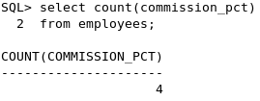
Aggregate Functions
COUNT(column)
  Returns the number of rows with non-null values for the column
Example:
  List the total number of employees who receive commissions
  SELECT COUNT(commission_pct) FROM employees;

Slide 19
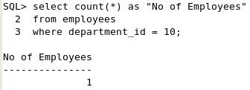
Aggregate Functions
COUNT(*)
  Return number of records (rows) in the table
  Includes duplicate rows and rows with NULL values
Example:
  List the total number of employees in department number 10.
  SELECT COUNT(*) AS “No of Employees”
  FROM employees
  WHERE department_id = 10;

Slide 20
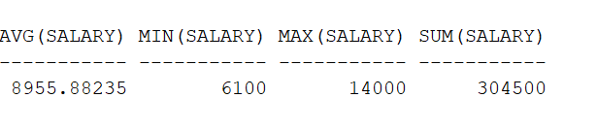
Aggregate Functions
Example:
  List the average, sum, minimum and maximum salary for employees in department number 80.
    Department number 80 has 34 employees
  SELECT AVG(salary),MIN(salary),MAX(salary),SUM(salary)
  FROM employees
  WHERE department_id=80;

Slide 21
Creating Groups of Data – GROUP BY
You can divide rows in a table into smaller groups by using the GROUP BY clause.
All columns in the SELECT list that are not in group functions must be in the GROUP BY clause.
  SELECT column, group_function(column)
  FROM table
  [WHERE condition]
  [GROUP BY group_by_expression]
  [ORDER BY column];
[ ] = OPTIONAL

Slide 22
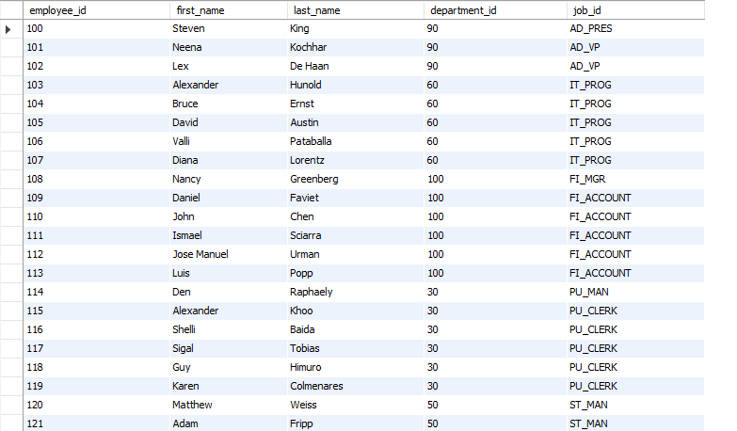
Creating Groups of Data – GROUP BY
What if:
List the department_id and number of staffs in each department.

Slide 23
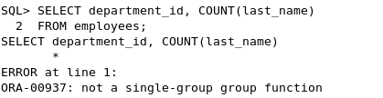
Creating Groups of Data – GROUP BY
Issue:
SELECT department_id, COUNT(last_name) FROM employees;
SOLUTION:
A GROUP BY clause must be added to count the last names for each department_id

Slide 24
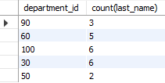
Creating Groups of Data – GROUP BY
  SELECT department_id, COUNT(last_name)
  FROM employees
  GROUP BY department_id;
Whenever you use a mixture of
  individual items (DEPARTMENT_ID) and
  group functions (COUNT)
  In the same SELECT statement,
  You must include a GROUP BY clause that specifies the individual item (in this case, DEPARTMENT_ID)

Slide 25
Creating Groups of Data – GROUP BY
What if:
List the department_id, job_id and number of staffs based on the job_id in each department.

Slide 26
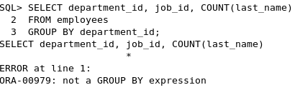
Creating Groups of Data – GROUP BY
Issue:
SELECT department_id, job_id, COUNT(last_name)
FROM employees
GROUP BY department_id;
SOLUTION:
Either add job_id in the GROUP BY clause or remove the job_id column from the SELECT list

Slide 27
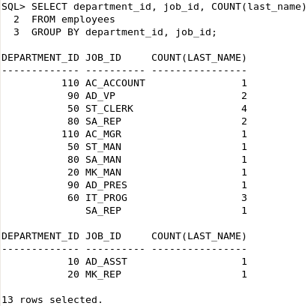
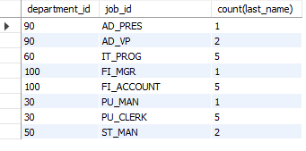
Creating Groups of Data – GROUP BY
  SELECT department_id, COUNT(last_name)
  FROM employees
  GROUP BY department_id;
Any column or expression in the SELECT list that is not an aggregate function must be in the GROUP BY clause
job_id is neither in the GROUP BY clause nor is it being used by a group function, so there is a “not a GROUP BY expression” error
We can correct this error by adding job_id in the GROUP BY clause

Slide 28
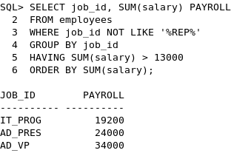
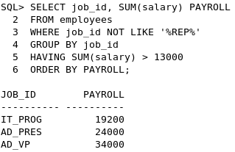
Creating Groups of Data – GROUP BY
List the job ID and total monthly salary for each job that has a payroll exceeding $13,000
It excludes sales representatives
It sorts the list by the total monthly salary

Slide 29
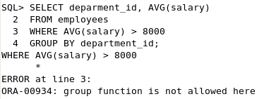
Illegal Queries Using Group Functions
You cannot use the WHERE clause to restrict groups.
You cannot use group functions in the WHERE clause.
Use HAVING clause to restrict groups.
Cannot use the WHERE clause to restrict groups

Slide 30
Restricting Group Results with the HAVING Clause
When you use the HAVING clause, the Oracle server restricts groups as follows:
  Rows are grouped.
  The group function is applied.
  Groups matching the HAVING clause are displayed.
  SELECT column, group_function(expr…)
  FROM table
  [WHERE condition]
  [GROUP BY group_by_expression]
  [HAVING group_condition]
  [ORDER BY column];
[ ] = OPTIONAL

Slide 31
Restricting Group Results with the HAVING Clause

Slide 32
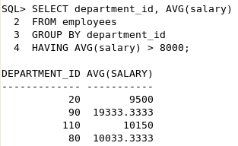
Restricting Group Results with the HAVING Clause
List the average salary for every department which has an average salary of $8000

Slide 33
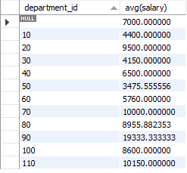
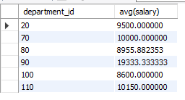
Restricting Group Results with the HAVING Clause
List the average salary for every department which has an average salary of $8000
SELECT department_id, AVG(salary)
FROM employees
GROUP BY department_id
HAVING AVG(salary)>8000;
SELECT department_id, AVG(salary)
FROM employees
GROUP BY department_id;

Slide 34
Summary
ORDER BY : To sort display in either ascending or descending order
Number functions : ROUND, TRUNC, MOD
Aggregate functions : COUNT, MAX, MIN, AVG
Grouping data: GROUP BY
Group functions
HAVING : use with conditions for restricting group results

Slide 35
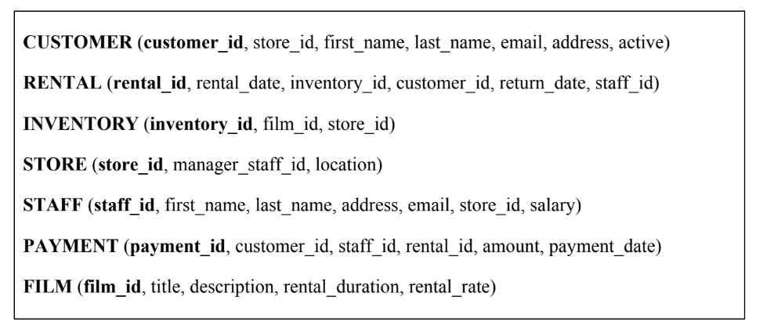
Simple Hand Written Exercise
Given the following relation schemas, construct the SQL statement for following tasks:
Schemas used in DML Question in Final Exam 2016/2017
The SQL query below returns an error. Revise the SQL query.
SELECT film_id, title AVG(rental_rate)
FROM FILM
WHERE AVG(rental_rate)<50
GROUP BY film_id;
List stores which has more than 100 inactive customer (the value in “active” attribute is either YES or NO)

